Slide 1
SENTIMENT ANALYSIS
By- Diya Roy RA1511003040185
Yash Tejwani RA1511003040183
Yatendra Gupta RA1511003040341

Slide 2
ABSTRACT
Our day-to-day life has always been inﬂuenced by what people think. Ideas and opinions of others have always aﬀected our own opinions. Analysis of public information from social media and internet could yield interesting results and insights into the world of public opinions about almost any product, service or personality. Sentiment Analysis or Opinion Mining is the computational treatment of opinions, sentiments and subjectivity of text. In this project , The method involves a bag-of-words model, which represents the sentence or document by a vector of words .and then we use the random forest as a classifier to classify the test data in positive or negative. The entire method used in this project will be implemented in python language.

Slide 3
APPLICATIONS
Movie: is this review positive or negative?
Products: what do people think about the new iPhone?
Public sentiment: how is consumer confidence? Is despair increasing?
Politics: what do people think about this candidate or issue?
Prediction: predict election outcomes or market trends from sentiment

Slide 4
EXISTING SYSTEM
In the existing system Naïve bayes classifier is used which is based on Bayes theorem. In Text classification we tokenize the document in order to classify it in its appropriate class. By using the “Max Posterior Probability” Decision rule.
In order to find in which class we should classify a new document, we must estimate the product of the probability of each word of the document given a particular class (likelihood), multiplied by the probability of the particular class (prior). After calculating the above for all the classes of set C, we select the one with the highest probability.

Slide 5
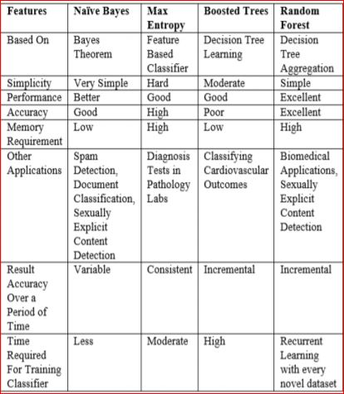

Slide 6
PROPOSED SYSTEM
In this project, we are using vector model in order to create the feature vectors for the training and testing dataset. And then create the bag of words of feature vectors.
Project uses Random forest as a classifier for classifying the training and testing dataset in positive and negative
Output is given as a rating of 0 and 1 based on positive or negative words

Slide 7
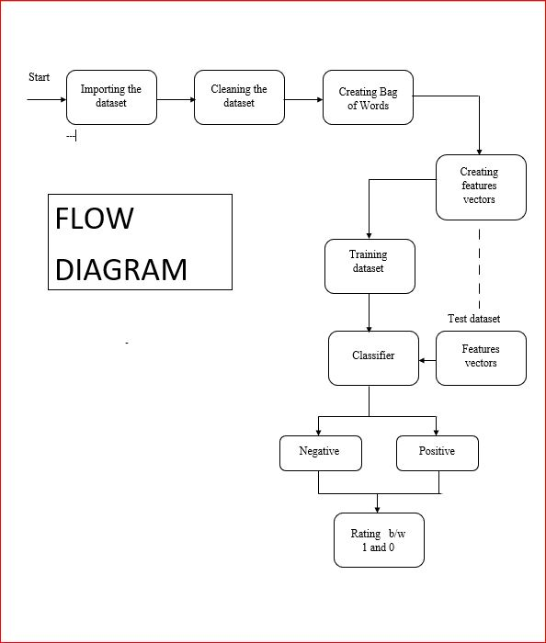

Slide 8
REFRENCES
http://papers.nips.cc/paper/5021-distributed-representations-of-words-and-phrases-and-their-compositionality.pdf
https://en.wikipedia.org/wiki/Word2vec
https://www.slideshare.net/MAtifQureshi/text-classification-sentiment-analysis
https://www.growthaccelerationpartners.com/blog/sentiment-analysis/
https://www.growthaccelerationpartners.com/blog/sentiment-analysis/

Slide 9
THANK YOU

